Slide 1
COMMUNITY COLLEGE TITLE IX COORDINATOR TRAINING November 30, 2023

Slide 2
TODAY'S WORK
Roles and Responsibilities at the Outset of a Complaint
Working through the Investigation and Decision-Making Process

Slide 3
TITLE IX COORDINATOR
Title IX Coordinator
A Title IX Coordinator's core responsibilities include overseeing the College's response to Title IX reports and complaints and identifying and addressing any patterns or systemic problems revealed by such reports and complaints.
This means that the Title IX Coordinator must have knowledge of the requirements of Title IX, of the College's own policies and procedures on sex discrimination and of all complaints raising Title IX issues throughout the College.

Slide 4
TITLE IX COORDINATOR
Coordinate the College's duty to PREVENT / INVESTIGATE / REMEDY
ensure policy / grievance procedures are updated
ensure notices are given to staff and students
ensure formal complaints are investigated
ensure appropriate steps to prevent immediate harm
ensure investigators are appointed and trained
ensure decision-makers are appointed and trained
ensure that appeals officers are appointed and trained
ensure proper record keeping
ensure proper interaction with law enforcement

Slide 5
BIAS, CONFLICTS OF INTEREST, AND RECUSALS
Bias can represent any variable that improperly influences a finding and/or sanction.
There are many forms of bias and prejudice that can impact decisions and sanctions:
Pre-determined outcome;
Partisan approach by investigators in questioning, findings, or report;
Partisan approach by decision-maker in questioning, findings, or sanction;
Intervention by senior-level institutional officials;
Improper application of institutional policies or procedures;
Confirmation bias;
Implicit bias; and/or
Animus of any kind.

Slide 6
SESSION ONE
One
Initial Steps and Intake
Two
Assessing Jurisdiction
Three
Managing Dismissals
Four
Documentation and Recordkeeping

Slide 7
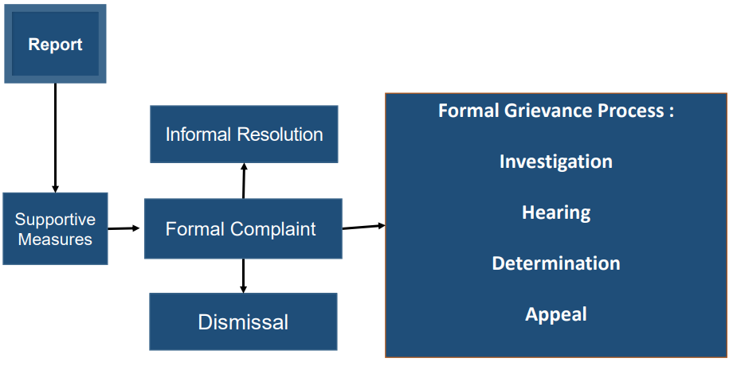

Slide 8
INITIAL STEPS

Slide 9
INITIAL COMPLIANCE STEPS
Identify your Title IX team.
Investigators, decision-makers, appeal entities, informal resolution facilitators, potential advisors.
Define roles and identify the required separation between them.
Consider your policy and procedure options.
Informal Resolution;
Formal Investigation; and
Code of Conduct.
How will you explain your process to others?

Slide 10
INTAKE

Slide 11
BEST PRACTICES FOR INTAKE
Determine jurisdiction and scope.
Offer AND document Supportive Measures.
Provide written documentation to a potential complainant of their rights and resources.

Slide 12
BEST PRACTICES FOR INTAKE
Explain options to a potential complainant.
Option One: do nothing.
Option Two: file a Formal Complaint and proceed with an Informal Resolution.
Option Three: file a Formal Complaint and proceed with an Investigation… including information that must be shared with a Respondent.
Option Four: the complaint does not meet the definition of "sexual harassment" – proceed under different policies.

Slide 13
INTAKE MEETINGS
Did you as the Title IX Coordinator receive a "Formal Complaint" from a "Complainant"?
Allegations against a Respondent?
Alleges Sexual Harassment?
Person is attempting to/participating in an education program or activity?
Person experienced the alleged Sexual Harassment?
The alleged Sexual Harassment occurred within the College's Title IX jurisdiction?

Slide 14
STRATEGIES FOR ADDRESSING A RELUCTANT COMPLAINANT
Don't pressure them to make a decision today.
Give them time to review their options.
Encourage them to reach out to a counselor as a supportive measure.
Schedule a check-in with them.
Ensure they understand potential consequences of whatever decision they make.

Slide 15
TITLE IX COORDINATOR-SIGNED FORMAL COMPLAINTS
When should the Title IX Coordinator file a Formal Complaint?
When the Coordinator determines a "non-deliberately indifferent response to the allegations requires an investigation."
Signing a Formal Complaint does NOT make the Coordinator a "complainant".
Examples:
Serial respondent; and
Pattern of alleged sexual harassment by a respondent in a position of authority.

Slide 16
ASSESSING JURISDICTION

Slide 17
WHAT CONDUCT IS COVERED?
Allegations of sexual harassment that occur in an education program or activity located within the United States and of which the recipient has actual knowledge.
If a person alleges misconduct that fits in the above description, institutions have a duty to respond. The Title IX Final Rule sets out your legal obligations in responding to such allegations.

Slide 18
EDUCATION PROGRAM OR ACTIVITY – REVIEW
"includes locations, events, or circumstances over which the recipient exercised substantial control over both the respondent and the context in which the sexual harassment occurs, and also includes any building owned or controlled by a student organization that is officially recognized by a postsecondary institution."
The easy ones:
Classrooms;
Cafeterias; and
On-campus office hours.

Slide 19
EDUCATION PROGRAM OR ACTIVITY – OFF CAMPUS?
Any of the three conditions must apply to extend Title IX jurisdiction off campus:
Incident occurs as part of the College's "operations";
If the College exercised substantial control over the respondent and the context of alleged sexual harassment; or
Incident occurred in an off-campus building owned or controlled by a student organization officially recognized by the College.

Slide 20
EDUCATION PROGRAM OR ACTIVITY – ONLINE STUDY
"Operations" of the College may include computer and online programs and platforms "owned and operated by, or used in the operation of, the recipient."
Still has to occur in educational program or activity…
And in the United States…

Slide 21
ACTUAL KNOWLEDGE
Notice of sexual harassment or allegations of sexual harassment.
To one of the following:
Title IX Coordinator, or
Any official of the College who has authority to institute corrective measures on behalf of the College.

Slide 22
HOW TO AVOID BEING "DELIBERATELY INDIFFERENT"
College officials with authority to correct sexual harassment shall respond promptly and impartially to actual knowledge of alleged sexual harassment in a manner that is not deliberately indifferent.
"Deliberate Indifference"
A college's response to the alleged harassment or the lack of any response is clearly unreasonable in light of the known circumstances AND such indifference either causes the person to undergo additional harassment, makes them vulnerable to further harassment, or otherwise contributes to the deprivation of access to an education program or activity.
Notes:
Supportive measures could include a mutual no contact order, mental health referral/supports, class change, grade extensions, etc.
Remember that colleges must be wary of OCR Compliance (OCR Complaint) and potential lawsuits by Plaintiffs, alleging we were deliberately indifferent. Lawsuits by Respondents that we didn't follow our policy.
The Fourth Circuit has given several examples to explain what may constitute deliberate indifference: 1) School officials trying to dissuade a student from taking any action against an alleged harassor. 2) School officials taking no action to protect a student, offer support, or report to the student's parents during a five-day class trip after school officials received reports alleging the student experienced nonconsensual sexual touching on the bus ride to the class trip. 3) Your investigator interviews the students involved in a sexual harassment allegation and two other students, but never speaks with other students who were identified as potential sources of information about the incident and aftermath. 4) Trying to sweep the matter under the rug so as not to cause trouble for the involved parties.

Slide 23
HOW TO AVOID BEING "DELIBERATELY INDIFFERENT"
Interactive Process:
Reach out to Complainant.
Offer Supportive Measures.
Consider Complainant's wishes with respect to Supportive Measures.
Supportive Measures can be given without filing a formal complaint.
Explain Title IX Grievance Process.
Implement Supportive Measures.
Notes:
Supportive measures could include a mutual no contact order, mental health referral/supports, class change, grade extensions, etc.
Remember that colleges must be wary of OCR Compliance (OCR Complaint) and potential lawsuits by Plaintiffs, alleging we were deliberately indifferent. Lawsuits by Respondents that we didn't follow our policy.
The Fourth Circuit has given several examples to explain what may constitute deliberate indifference: 1) School officials trying to dissuade a student from taking any action against an alleged harassor. 2) School officials taking no action to protect a student, offer support, or report to the student's parents during a five-day class trip after school officials received reports alleging the student experienced nonconsensual sexual touching on the bus ride to the class trip. 3) Your investigator interviews the students involved in a sexual harassment allegation and two other students, but never speaks with other students who were identified as potential sources of information about the incident and aftermath. 4) Trying to sweep the matter under the rug so as not to cause trouble for the involved parties.

Slide 24
RESPONSE TO "ACTUAL KNOWLEDGE"
Promptly contact Complainant to discuss availability of supportive measures.
Consider Complainant's wishes with respect to supportive measures.
Follow a grievance process that complies with federal regulations.

Slide 25
JURISDICTIONAL DETERMINATIONS
Jurisdictional issues can arise at any time during the grievance process.

Slide 26
2023 REGULATIONS
Removes requirement of written Complaint.
Changes "sexual harassment" to "sex-based harassment", widening the circle of Title IX to all types of sex discrimination, including sexual harassment, athletics, employment, and pregnant/parenting accommodations.
Changes "severe AND pervasive" to "severe OR pervasive" re: "unwelcome conduct".
Requires institutions address a sex-based hostile environment in its education program or activity when sex-based harassment occurred outside the institution's education program or activity.

Slide 27
MANAGING DISMISSALS

Slide 28
CLOSING A REPORT OR COMPLAINT
MANDATORY
PERMISSIVE
Allegations, even if proven, would not constitute a violation of Title IX Policy.
Alleged sexual harassment did not occur in an education program or activity or in the U.S.
Complainant requests withdrawal.
Respondent is no longer enrolled or employed by the College.
College is prevented from gathering sufficient evidence.

Slide 29
PROCEDURE TO CLOSE A REPORT OR COMPLAINT
Title IX Coordinator must notify parties, including:
The reason(s) for closure;
Parties' rights to appeal; and
Directions to an appropriate College office or department to resolve the report or complaint, if any.

Slide 30
DISMISSAL/EXIT RAMP SCENARIOS
Each of the hypothetical facts below will build upon one another. Consider the following questions for each new fact:
What do I do with this if it comes to the Title IX Office?
Does the conduct at issue, if true, fall under Title IX's definition of sexual harassment?
If not, does it need to go somewhere else?
Does the conduct at issue, if true, fall under Title IX's jurisdiction?
If not, does it need to go somewhere else?

Slide 31
DISMISSAL/EXIT RAMP SCENARIOS
Joe and Sally are dating. Sally suspects Joe is cheating on her and calls the Title IX office to report him.
Sally logs on to Joe's email account and finds an email from Becky that sets up a rendezvous in Joe's room.
Sally grabs her best friend Angela to go confront Joe.
Sally is mad and busts the lock on Joe's door to get into his room.
Angela turns on her iPhone video to record the encounter.
Joe and Becky are in bed having sex.
Sally and Angela enter Joe's room, Sally screams at Joe and slaps him across the face.
Sally pulls Becky out of bed, naked, and kicks her while she is on the floor.
When Becky tries to leave the room, Sally grabs her breast and twists it, then threatens to kill her if she comes anywhere near Joe again.
Becky leaves and runs out the door naked to her room down the hall.

Slide 32
DISMISSAL/EXIT RAMP SCENARIOS
Joe shoves Sally and Angela out of his room so he can get dressed.
Angela uploads the video to YouTube, then tweets the link and tags Joe and Becky. She titles the video "Little D*ck and the Skank".
Within minutes, Joe and Becky have hundreds of comments directed towards them on social media. Some are negative and some are threatening.
When Becky reads the messages, she begins to send texts to Sally: "I'm coming after you." "I see you across the Quad." "Don't go into that room alone or I'll get you." Becky sends approximately fifty similar messages over the course of the next two hours.
Joe opens his closet to get dressed and lets his friend, Jim, out from where he was watching it all.

Slide 33
2023 REGULATIONS
No mandatory dismissals.
A Title IX Complaint may be dismissed if:
College is unable to identify the Respondent;
Respondent is not an employee or is not participating in a College education program or activity;
Complainant voluntarily withdraws any part of the allegations and without the withdrawn allegations, the remaining conduct would not constitute sex-based harassment; or
The alleged misconduct, even if proven, would not constitute sex-based harassment.

Slide 34
DOCUMENTATION AND RECORDKEEPING

Slide 35
TITLE IX TRAINING FOR TITLE IX PERSONNEL
Annual training must be provided to Title IX Coordinators, investigators, decision-makers, and those involved in informal resolution.
Training in the following topics is mandatory:
The definition of sexual harassment for Title IX purposes.
The scope of education programs and activities.
How to conduct an investigation and grievance process, including hearings, appeals, and informal resolution.
How to serve impartially.
Technology to be used at hearings.
Issues of relevance of questions and evidence at hearings.
Issues of relevance in creating investigation reports.

Slide 36
COMPLIANCE REQUIREMENTS
All training materials must be posted on Colleges' websites.

Slide 37
MAINTAINING RECORDS
Reports and Formal complaints, including the basis for why the institutional response was not deliberately indifferent;
Any actions taken in response to the report or formal complaint, including any supportive measures implemented;
If supportive measures were not provided, reasons for why that was not clearly unreasonable in light of the known circumstances and
Records must show measures taken are designed to restore or preserve equal access to education programs and activities.

Slide 38
MAINTAINING RECORDS
Investigation records, such as investigator notes, documentary evidence collected, and the investigative report;
Written determinations, sanctions, and remedies;
Any recordings or transcripts from any live hearings;
Appeals;
Informal resolutions; and
Training materials.

Slide 39
WHERE CAN STUDENTS / EMPLOYEES FIND THIS INFORMATION?
College Policy
College website and all student and employee handbooks:
A statement of the College's policy of nondiscrimination on the basis of sex.
Title IX Coordinator's contact information.
A statement that Title IX inquiries may be referred to the Title IX Coordinator or to the Assistant Secretary for Civil Rights.

Slide 40
COLLEGE WEBSITE
The College does not discriminate on the basis of sex in its education programs or activities and is required by Title IX of the Education Amendments Act of 1972 and federal regulations to not discriminate in such a manner. This requirement extends to admission and employment.
Inquiries about the application of Title IX and its implementing federal regulations may be referred to the Title IX Coordinator and/or the Assistant Secretary for Civil Rights in the Office for Civil Rights at the U.S. Department of Education.
The Title IX Coordinator's contact information is: ______________.
All training materials.

Slide 41
SESSION TWO
One
Investigations – What's Your Role?
Two
Informal Resolutions
Three
Making Supportive Measures Count
Four
Prevention, Program Assessment, and Partnerships

Slide 42
INVESTIGATIONS – WHAT'S YOUR ROLE?

Slide 43
WHEN TO ACT
When a College has "actual knowledge" of possible sexual harassment, it must undertake immediate and appropriate steps to offer supportive measures and determine if an investigation is required or requested.
College will be deemed to have actual knowledge if the Title IX Coordinator or any College official with authority to institute corrective measures has notice of allegations of sexual harassment.
College must not be "deliberately indifferent".

Slide 44
WHEN TO ACT
Other sources of notice:
Community: social media, print/television, community members.
"Credible reports" of sexual harassment, particularly a pattern of acts against multiple students.
"Widespread, openly practiced, or well-known" among students/employees.

Slide 45
WHEN TO INVESTIGATE
Do the allegations as stated constitute a violation of College policy? (including whether the alleged conduct occurred in an education program or activity, located within the US, of which the College has actual knowledge)
If yes, does Complainant want to pursue a formal investigation?
If yes, investigate.
If no, are the allegations of the type that the College must investigate regardless of Complainant's wishes?

Slide 46
WHEN TO INVESTIGATE
Factors to consider if a Complainant does not want an investigation:
The more serious the conduct, the higher need to investigate (e.g., one instance of rape).
The more frequent the conduct, the higher the need to investigate (e.g., widespread behavior against multiple victims).

Slide 47
ACTING V. INVESTIGATING
Immediate Steps:
Communicate with individual who reported conduct;
Implement supportive measures;
Share College policy and procedure; and
Determine whether allegations fall within Title IX Policy.

Slide 48
FORMAL COMPLAINTS
May only be initiated/submitted by Complainant or Title IX Coordinator.
Should include:
Name and address of Complainant;
Description of alleged sexual harassment;
Request to investigate; and
Signature of Complainant.

Slide 49
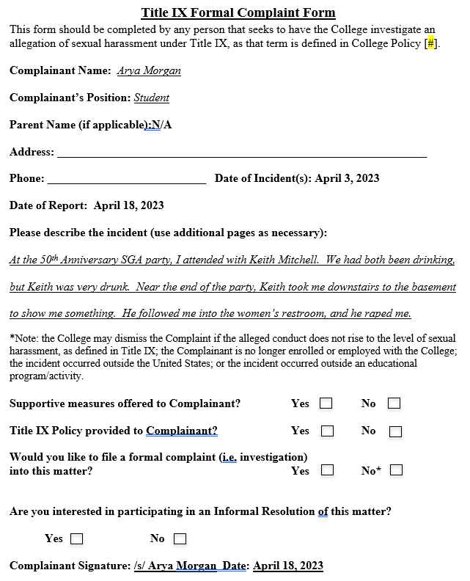

Slide 50
KEYS TO RESPONDENT CONTACT
Both parties may be emotional and may need access to supportive measures and resources.
Be sensitive and refrain from comments that blame either party, suggest disbelief/prejudgment, or discourage participation in the process.
Document your interactions in writing after speaking with a party.

Slide 51
CONSOLIDATION OF FORMAL COMPLAINTS
Provided the allegations arise out of the same facts or circumstances, colleges are permitted to consolidate formal complaints that are:
Against more than one Respondent.
By more than one Complainant against one or more Respondents.
By one party against the other party.

Slide 52
REMOVAL/LEAVE
College is permitted to remove a Respondent from school on an emergency basis, provided the College:
Undertakes an individualized safety and risk analysis;
Determines an immediate threat to the physical health or safety of any person arising from the allegations justifies removal; and
Provides the Respondent with notice and an opportunity to challenge the decision immediately following the removal.
College is permitted to place an Employee-Respondent on administrative leave with pay during the pendency of its grievance process.

Slide 53
ELEMENTS OF INVESTIGATION
Title IX Coordinator: Written Notice of Allegations to Parties
Sufficient details to allow parties to respond and prepare for initial interviews;
Identity of the parties involved;
Conduct alleged to be sexual harassment;
Date and location of alleged incidents;
Statement that Respondent is presumed not responsible and responsibility determination is made at conclusion of process;
Parties' right to an Advisor;
Parties' right to review evidence; and
Notice that College prohibits making knowingly false statements or submitting false information.

Slide 54
ELEMENTS OF INVESTIGATION
Title IX Coordinator: Written Notice of Allegations to Parties
Must be supplemented if new allegations are to be investigated.

Slide 55
ELEMENTS OF INVESTIGATION: FACILITATE REVIEW OF EVIDENCE
May need to facilitate parties' opportunity to inspect and review any evidence obtained as part of the investigation.
Parties are to be provided at least 10 days to submit a written response to the evidence before completion of an investigative report.
Review process may be managed by the Title IX Coordinator.

Slide 56
IMPARTIALITY
Be netural. Keep an open mind and actively listen.
Determine whether there should be objective rules for determining bias or conflict of interest if raised during the grievance process.
No per se prohibited conflicts of interest in using employees or administrative staff for any and all Title IX roles.
No per se violations for conflict of interest or bias for professional experiences or affiliations of decision-makers and other roles in the grievance process.
Each case is unique and different!

Slide 57
SCENARIOS
Scenario for the next several hypotheticals: You are the Title IX Coordinator and have just received a complaint. An initial review did not identify you or anyone else on your team as having any conflicts of interest. Assess the following situations based on additional information you receive.

Slide 58
SCENARIO 1
You review the report and realize the name of the Complainant seems familiar to you from a past and unrelated investigation. You don't have any real memory of the case, but the Complainant has requested a meeting with you to discuss supportive measures. What should you do?

Slide 59
SCENARIO 2
You have three Investigators in your office that have worked together for years and often "vent" to one another about the pressures of working in Title IX and the things that frustrate them about their cases. They also encourage one another and help troubleshoot best practices for particular cases. Your institution does not have the budget to hire additional staff or outsource the new Title IX roles required by the 2020 regulations. You want to use your current staff of investigators on a rotating basis, in which they sometimes serve as an informal resolution facilitator or decision-maker for cases they don't directly investigate. Is this allowed?

Slide 60
SCENARIO 3
Your institution's student conduct office and student life office meet weekly to discuss student issues and potential issues. In these meetings, you discuss specific students' names for continuity of care and to ensure everyone is on the same page. As a result, you have heard other employees discuss the parties in the case handed to you and some of it seemed to indicate that the Complainant may be dramatic. What should you do?

Slide 61
SCENARIO 4
You assign Jessica to serve as a Decision-Maker for a particular case. Jessica has served in this role before and has issued five decisions in other cases. A few days later, Jessica contacts you to let you know that one of the witnesses in the current case testified in a prior case. In the prior case, this witness gave inconsistent statements and was often refuted by contradictory documentary evidence. While the prior decision was polite about it, Jessica ultimately found that this person's testimony was not credible. Jessica believes she can set that aside and be impartial in the new case but wanted to alert you to the issue. What should you do?

Slide 62
INFORMAL RESOLUTIONS

Slide 63
WHAT IS AN INFORMAL RESOLUTION?
No definition in the regulations.
"unnecessary"
"Informal resolution may encompass a broad range of conflict resolution strategies, including but not limited to arbitration, mediation, or restorative justice."

Slide 64
INFORMAL RESOLUTION
Informal resolution may not be used for a student's allegations against a College employee.
Voluntary – parties must provide written consent.
Independent, neutral person facilitates informal resolution (not the Title IX Coordinator).
Process may end at any time prior to resolution agreement.

Slide 65
INFORMAL RESOLUTION
Title IX Coordinator provides notice to parties of:
Allegations of sexual harassment;
Requirements of the informal resolution process; and
Potential outcomes resulting from participating in the informal resolution process.
Resolution is concluded only when all parties have signed a written agreement.
Agreement is non-revocable and non-appealable.

Slide 66
MAKING SUPPORTIVE MEASURES COUNT

Slide 67
DEFINING SUPPORTIVE MEASURES
Non-disciplinary, non-punitive individualized services offered as appropriate, as reasonably available, and without fee or charge to the Parties.
Available with or without the filing of a Formal Complaint.
Designed to restore or preserve equal access to a College's education program or activity without unreasonably burdening the other Party; protect the safety of all parties and the educational environment; and deter sexual harassment.

Slide 68
GUIDING PRINCIPLES
Requirement to provide to all parties.
Equity.
Restoring access.
Empowering choice and agency.
Addressing harm.

Slide 69
CATEGORIES OF SUPPORTIVE MEASURES
Physical safety
Mental well-being
Academic
Housing
Employment
Extracurricular
Pregnancy-specific

Slide 70
DETERMINING APPROPRIATE SUPPORTIVE MEASURES
What are the facts and circumstances of the situation?
Example: a student-complainant tells the Title IX Coordinator that another student seems to be waiting for them outside their classes and they are afraid for their safety. They request a campus police officer escort them around-the-clock while on campus.
Must maintain confidentiality to the greatest extent possible.
Should supportive measures be continued after a determination of non-responsibility?

Slide 71
EVALUATING SUPPORTIVE MEASURES
Individual check-ins
Data analysis
Collaboration with other Colleges

Slide 72
PREVENTION, PROGRAM ASSESSMENT, & PARTNERSHIPS

Slide 73
Campbell Shatley, PLLC 674 Merrimon Ave., Suite 210 Asheville, NC 28804 (828) 398-2776

